Slide 1
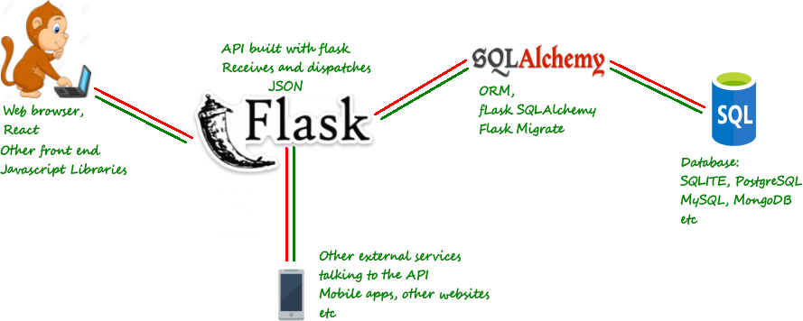
Architecture & Project components
Part 1:React.js + Material-UI
Part 3: Save user+ drug info
Part 4: Deployment
Flask+DB+React@AWS
Part 2: Fetch data from open API
about pills & side-effects

Slide 2
To read/do:
Front End (React.js + Material UI) :
https://medium.freecodecamp.org/meet-your-material-ui-your-new-favorite-user-interface-library-6349a1c88a8c
More advanced: https://medium.com/codingthesmartway-com-blog/getting-started-with-material-ui-for-react-material-design-for-react-364b2688b555
Authorization part (Flask, SQLAlchemy, SQLite, RESTful API):
https://codeburst.io/jwt-authorization-in-flask-c63c1acf4eeb
Serial of tutorial on Flask: https://danidee10.github.io/blog/page2/
React+Flask+Deployment:
https://codeburst.io/creating-a-full-stack-web-application-with-python-npm-webpack-and-react-8925800503d9
Flask+SQLAlchemy @ AWS:
https://medium.com/@rodkey/deploying-a-flask-application-on-aws-a72daba6bb80
Other useful:
Flask short tutorials with examples: https://www.tutorialspoint.com/flask/flask_http_methods.htm
More detailed Material-UI: https://blog.logrocket.com/the-definitive-guide-to-react-material-d730c8a3e8ba

